Slide 1
The History Of Water
Fluoridation
Shuo Sun
Mainly based on Janie Coulombe’s PPT in 2016

Slide 2

Two stories unfolded over more than 50 years:
Harmful effects of fluoride in large doses
Dental benefits from small doses

Slide 3
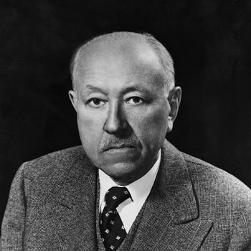
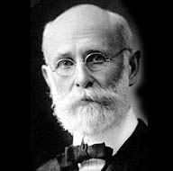
The first findings
The foundation of water fluoridation in the U.S. was made by Frederick S. McKay (1874–1959), dentist
Begin in 1901, McKay gave systematic attention to the mottling and brown stain he found on the teeth of many of his patients in Colorado Springs, and hypothesized it’s due to water supply
By 1909 McKay studied enough cases + help of Dr. G. V. Black discovers that fluoride is connected with prevention of dental caries
Notes:
Colorado brown stain, Colorado State Dental Association to invite Dr. Green Vardiman Black

Slide 4
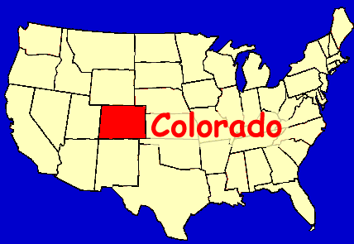
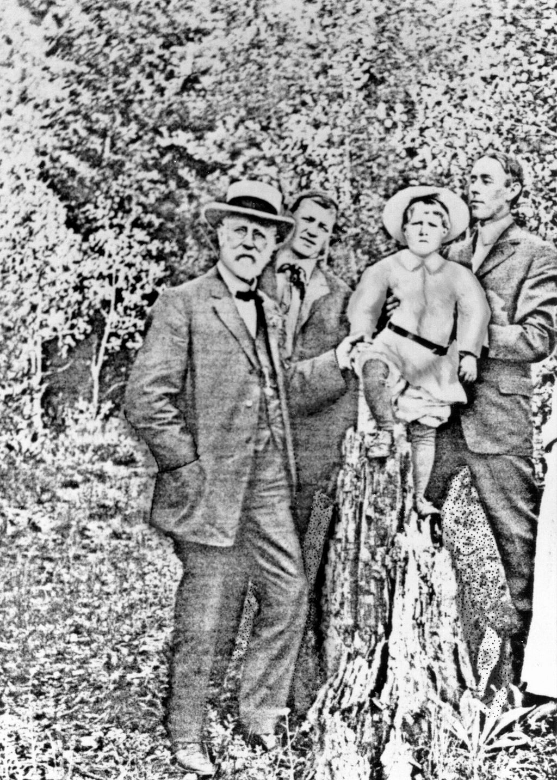
A Fruitful Collaboration
Black’s visit gained national attention to the phenomenon and afterwards, many cases were reported from other parts of the country
The name “Colorado brown stain” eventually gave way to that of mottled enamel and the process soon became associated with communal water supplies

Slide 5
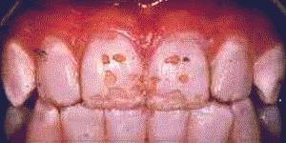
Harmful effects of fluoride
Studies initiated in 1928 in Bauxite, Arkansas, samples came to the laboratory of H. V. Churchill, chief chemist for ALCOA - 13.7 parts per million of fluoride found in the Bauxite water
McKay was notified in 1931: high levels of water fluoride indeed caused the discoloration of tooth enamel
Many parts of the United States soon developed a striking correlation between mottled enamel and a fluoride content of public water ranging from 2 to 13 ppm

Slide 6
Benefits of fluoride on dental health
McKay's and Black's studies on fluorosis that mottled tooth enamel is unusually resistant to decay
In 1930s, Dr. H. Trendley Dean found: adding fluoride to drinking water at safe levels would help fight tooth decay
In 1945, Grand Rapids, Michigan became the first city in the world to fluoridate its drinking water
After just 11 years, Dean found the caries rate among Grand Rapids children born after fluoride was added to the water dropped more than 60%

Slide 7
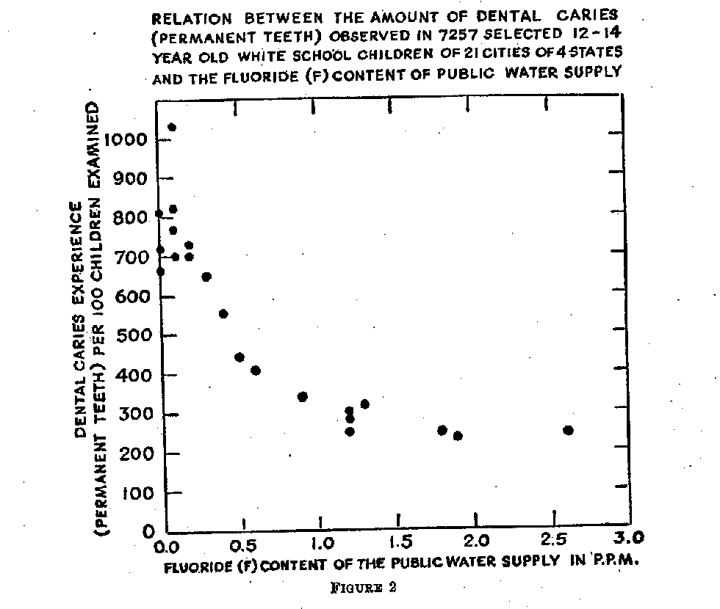
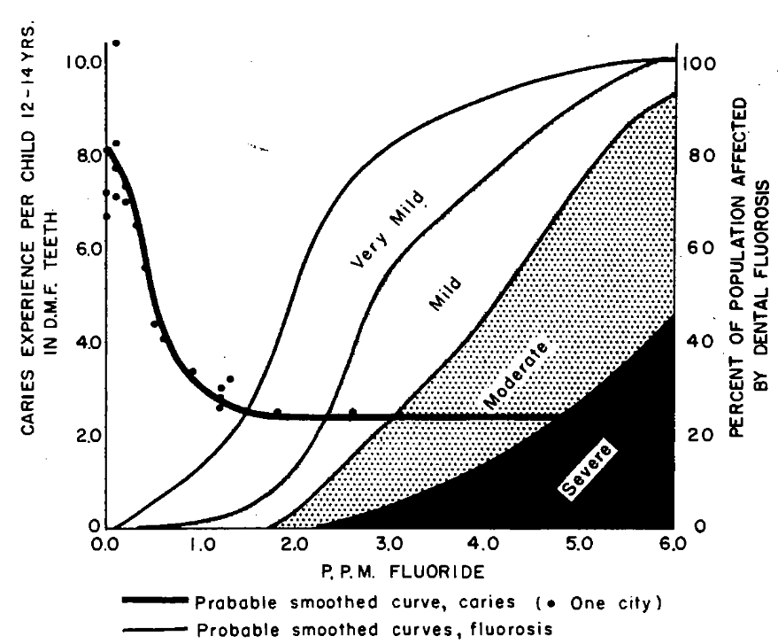

Slide 8
Pilot studies …
Started in 1945 in New York, Michigan, Ontario
All reports showed improvements in Newburgh and lack of improvement in Kingston (control)
At the same time, pediatric study (Kingston being the control) – after 10 years, no major issue or difference

Slide 9
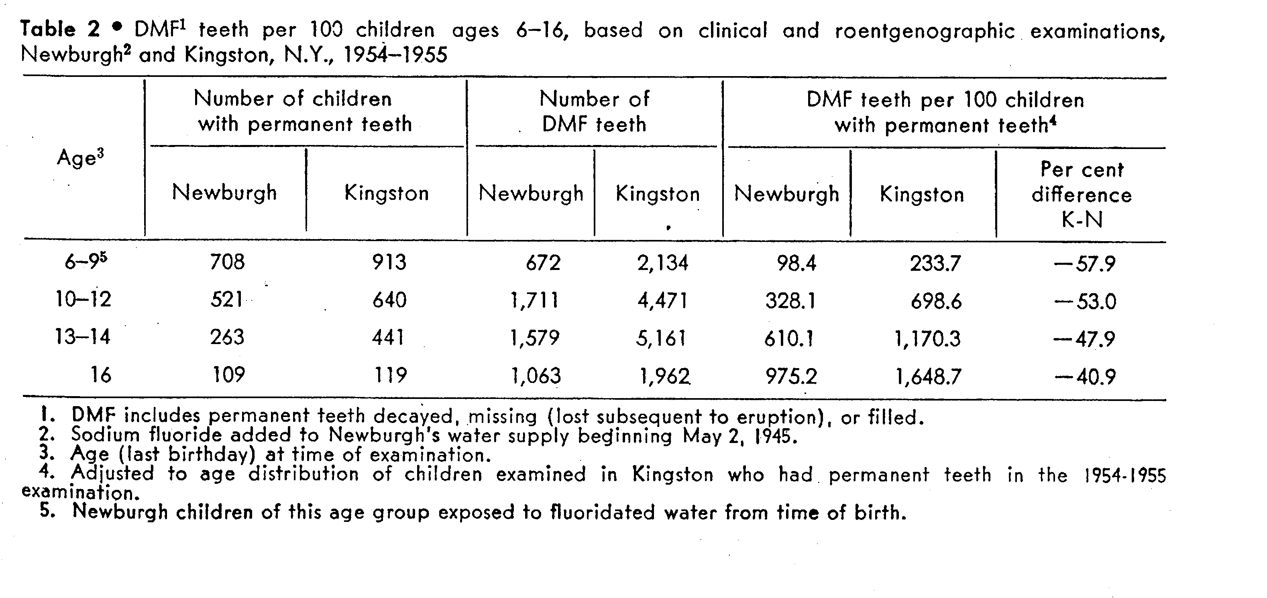

Slide 10
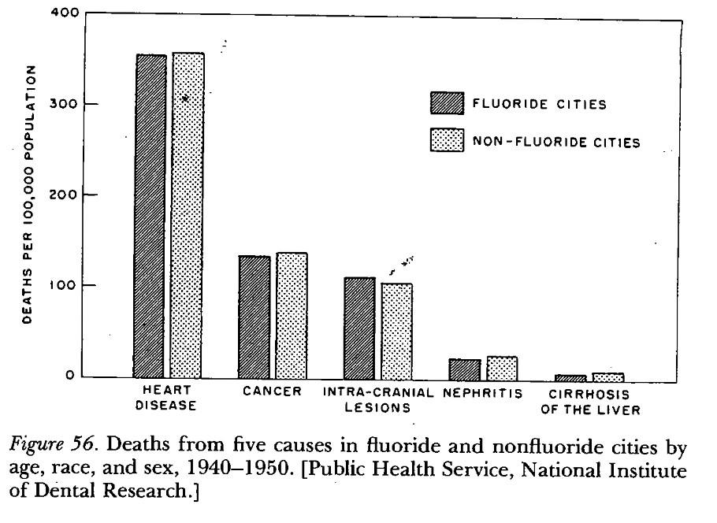

Slide 11
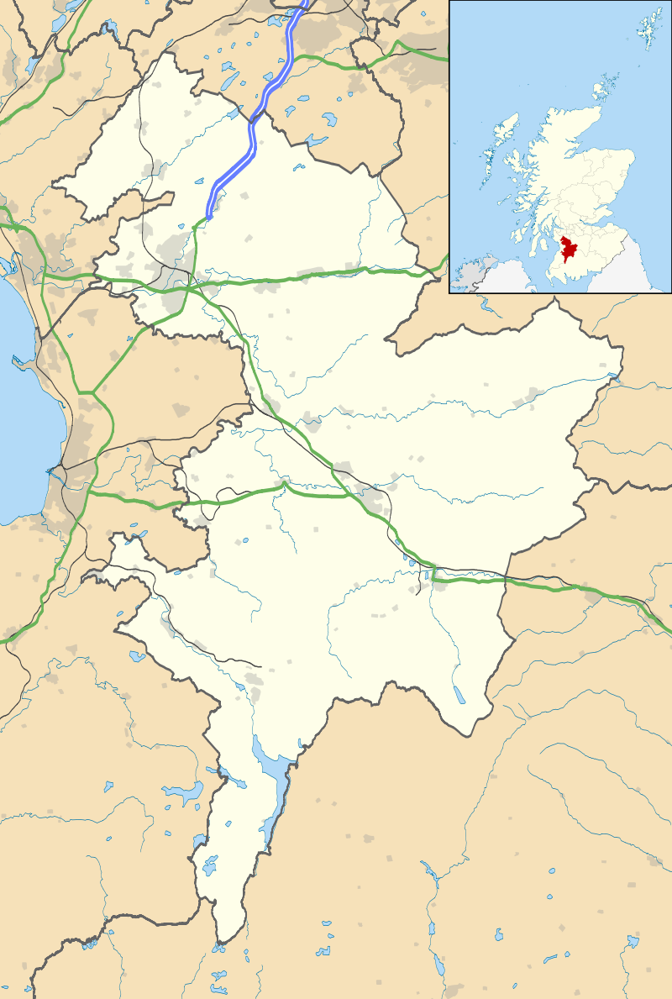
The Kilmarnock Studies
Fluoridation began in April 1956, ceased in October 1962
Samples of children in age range 3-14 were examined annually in Kilmarnock (treatment) with comparable samples in Ayr (control)
Notes:
assess the effects of six and a half years of fluoridation on children’s teeth and to determine the subsequent effects of reverting to an unfluoridated water supply.

Slide 12
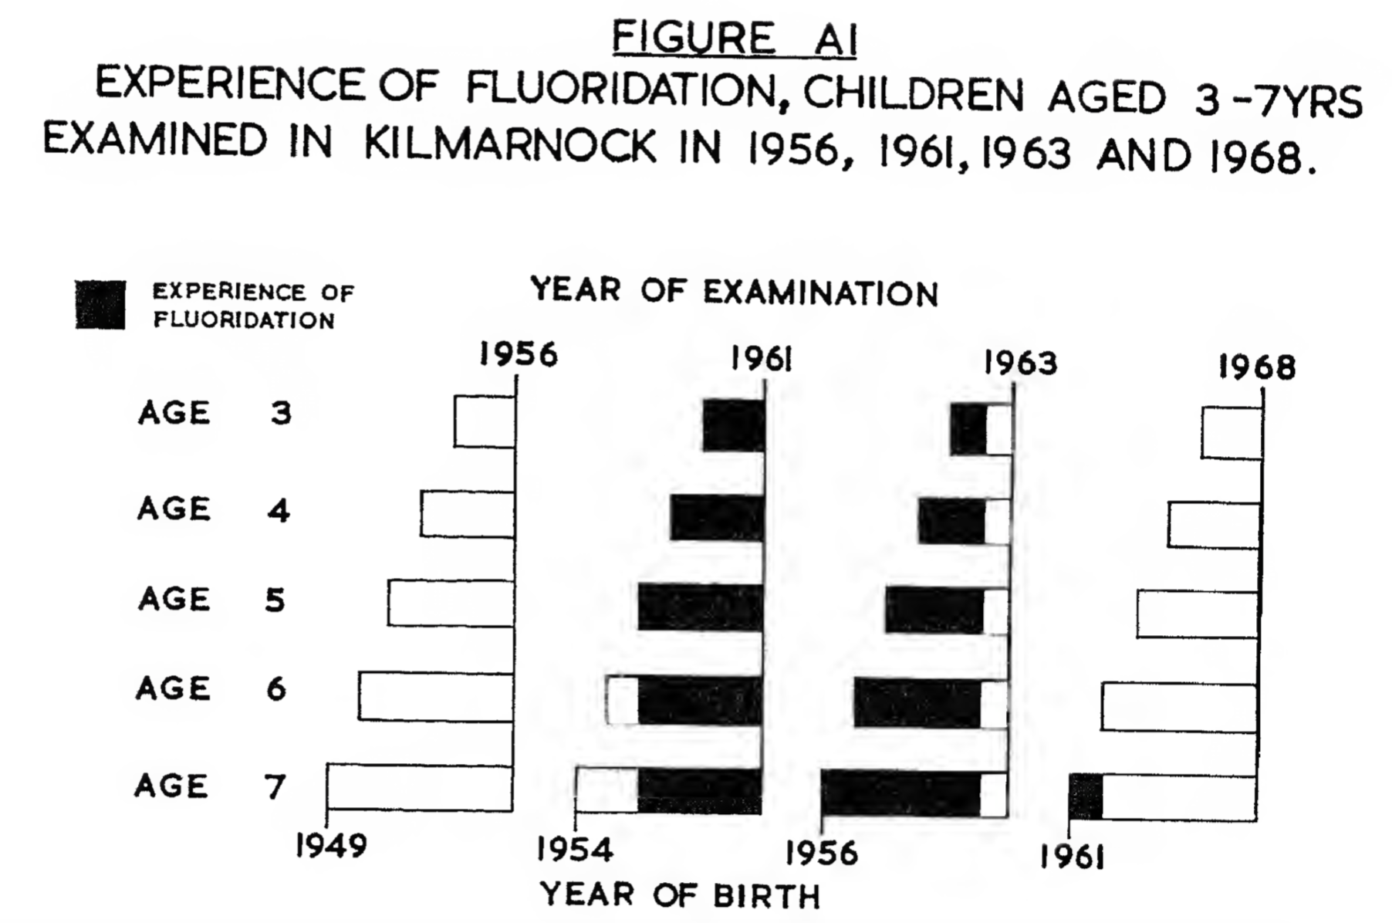
The Kilmarnock Studies
Notes:
Sample distribution:
1956: None of the Kilmarnock children had any experience of fluoridation.
1961: After five years of fluoridation in Kilmarnock the teeth of children up to 5 years of age had had the full effects of fluoridation and the older children had not experienced the full effect.
1963:Allchildrenuptotheageof7yearshadexperiencedfluoridation from birth until 1962, when fluoridation ceased.
1968: Only the 6- and 7-year-old children had experienced some fluoridation of short duration.

Slide 13
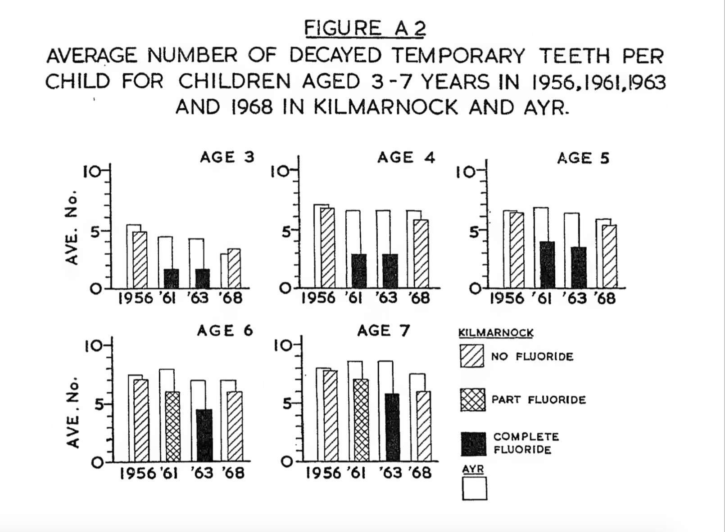
The Kilmarnock Studies (Temporary Teeth)
Notes:
temporary teeth begin to form before birth and their calcification is completed by one year of age.

Slide 14
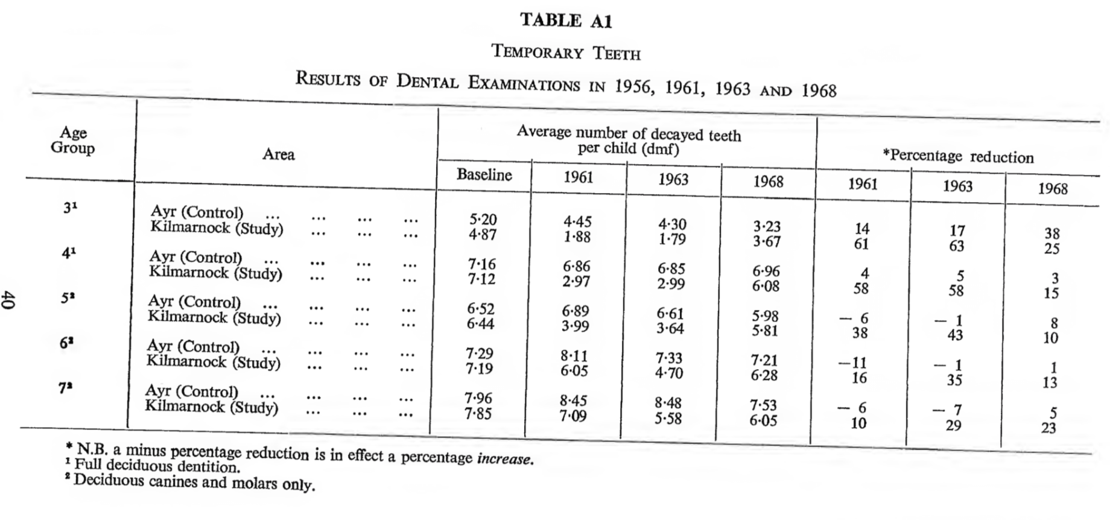
The Kilmarnock Studies (Temporary Teeth)
Notes:
temporary teeth begin to form before birth and their calcification is completed by one year of age.

Slide 15
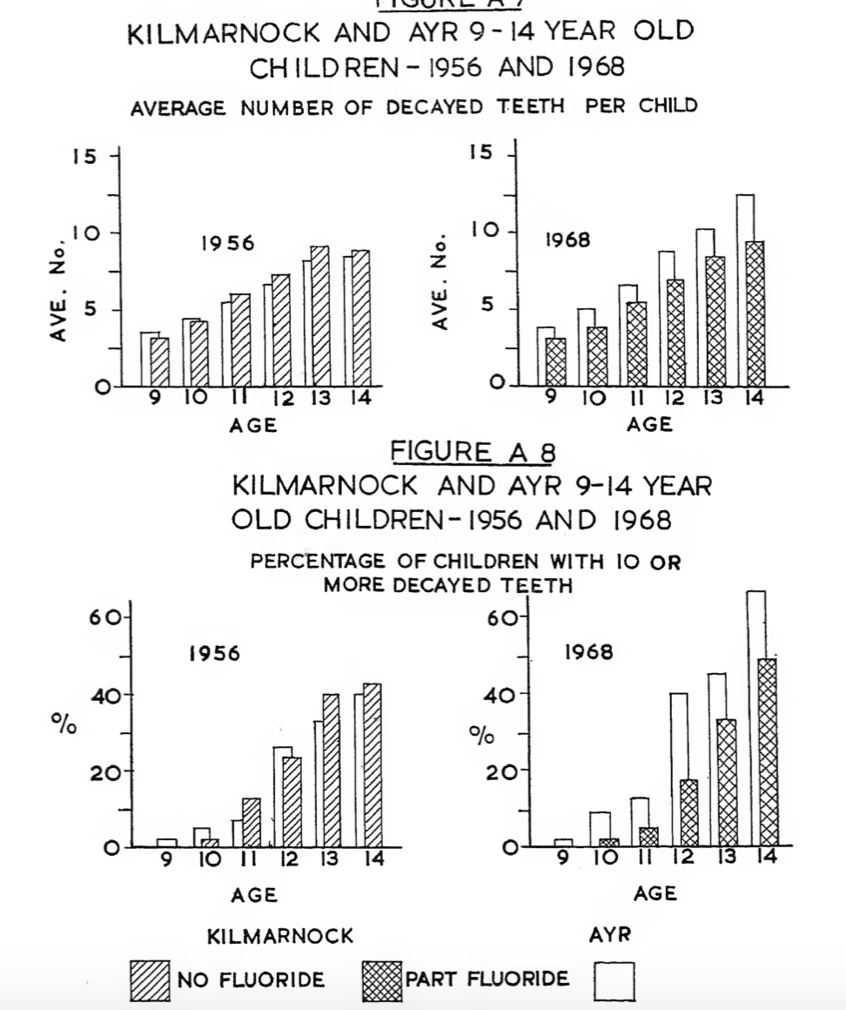
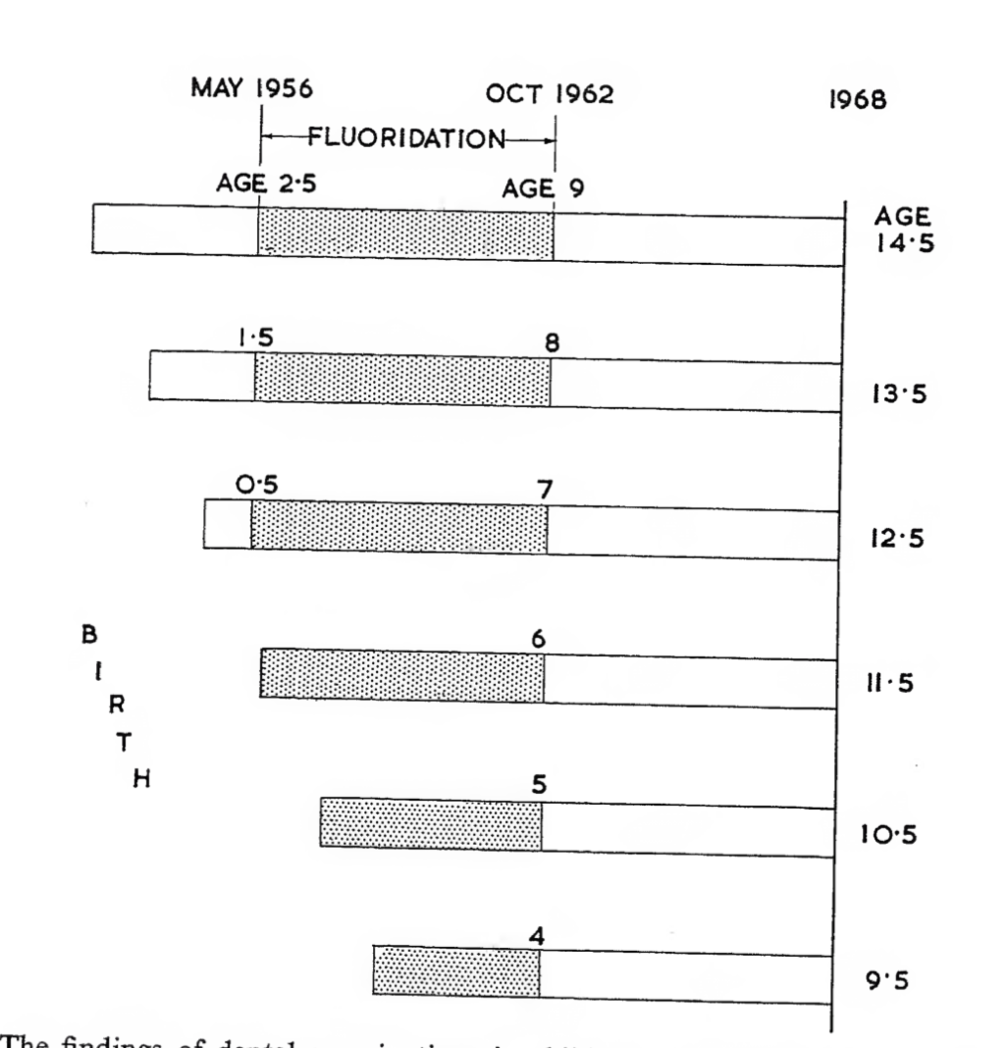
The Kilmarnock Studies
(Permanent Teeth)
Notes:
permanent teeth develop over a period extending from birth to 12 years of age.
Not full effect, but exert some influence

Slide 16
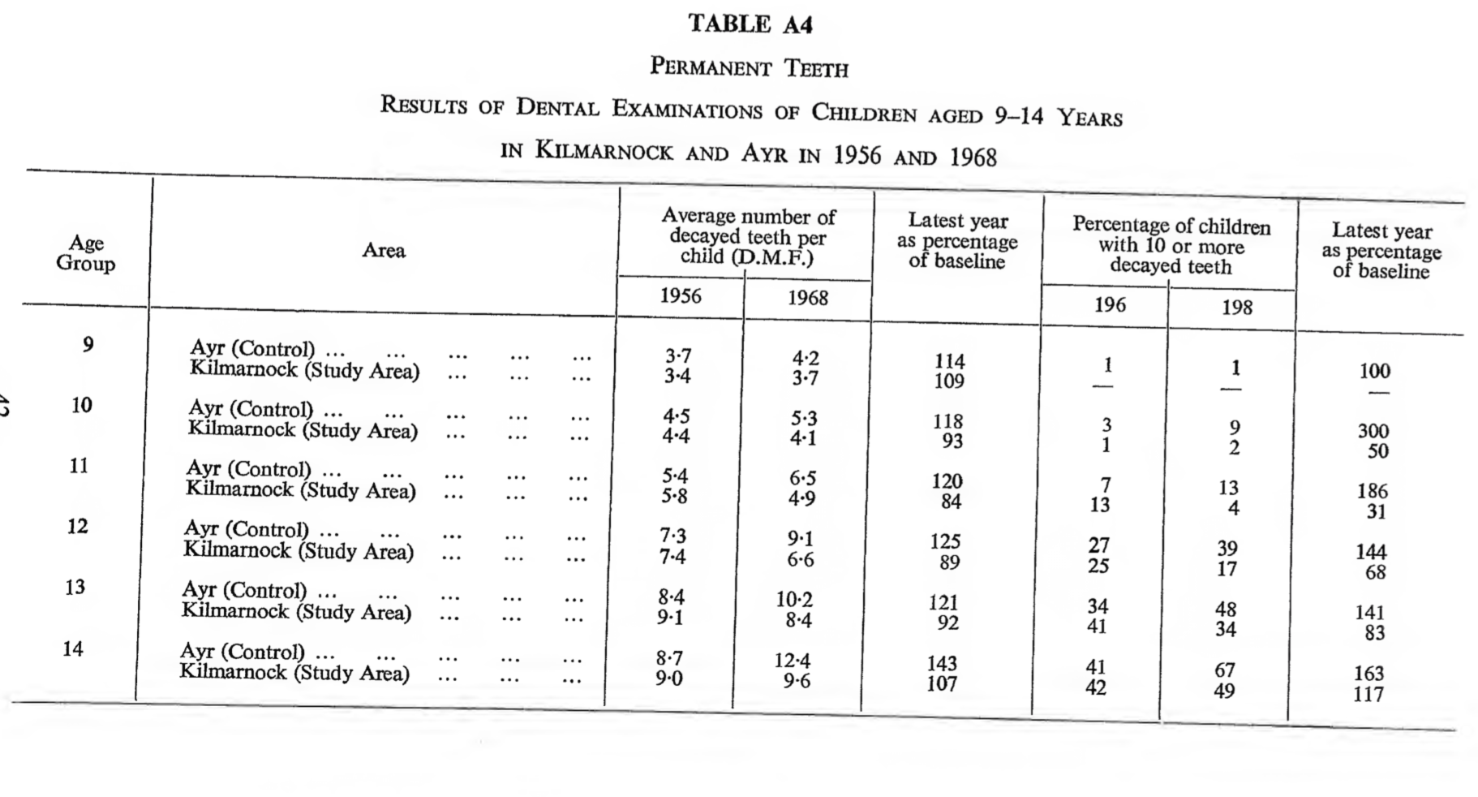
The Kilmarnock Studies (Permanent Teeth)
Notes:
permanent teeth develop over a period extending from birth to 12 years of age.
Not full effect, but exert some influence

Slide 17

And since then…

Slide 18
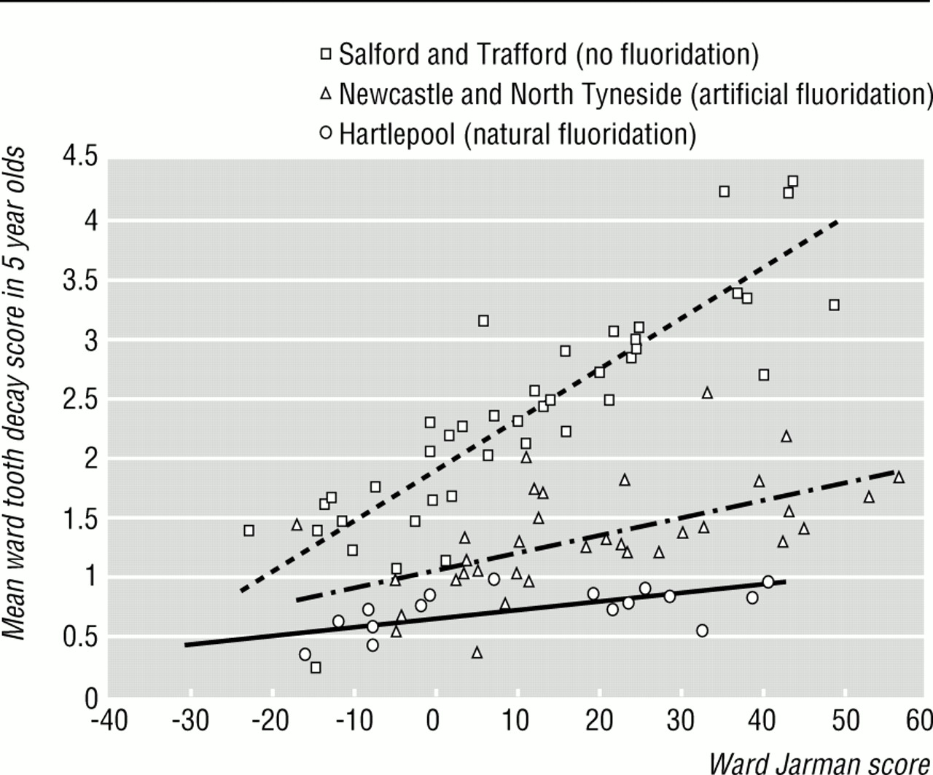
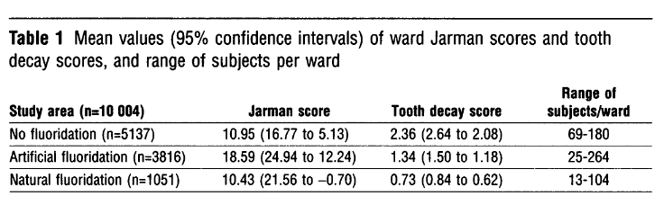
In relation with the social status (1991)
NHS dental surveys in 5 years old
1991 census – electoral wards in
Hartlepool, Newcastle and North Tyneside
(Fluoridated), and Salford, Trafford (Non)
N=10,004 children
Ward tooth decay score vs Jarman score
(underprivileged area score)
Notes:
combined this information with 8 Census variables into a single deprivation index
A positive score equates with deprivation, demand for primary care

Slide 19
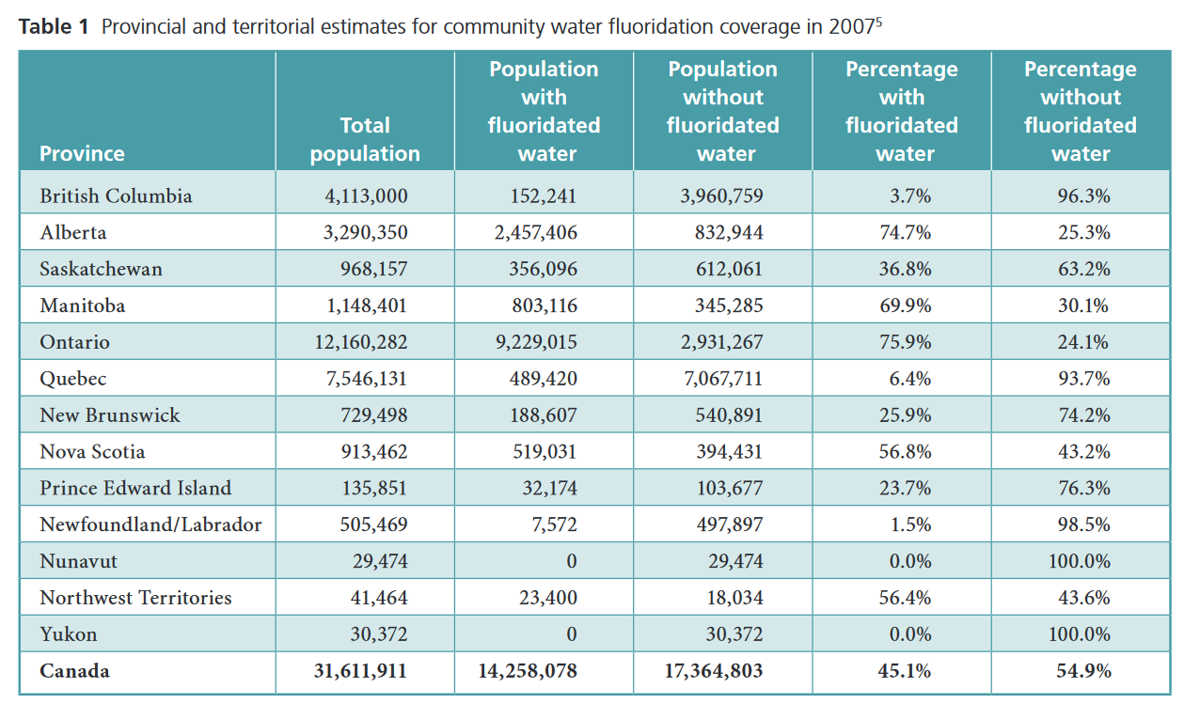
CMAJ – Canada (past and present)

Slide 20
Debate …
Dental disease is the number one chronic disease in children
Research continues to show that fluoride reduces tooth decay (20 to 40%)
It benefits everyone regardless of age, socio-economic status, education or employment
0.7 PPM would be enough
Cost of water fluoridation
Environmental pollution
Health risks
human rights

Slide 21
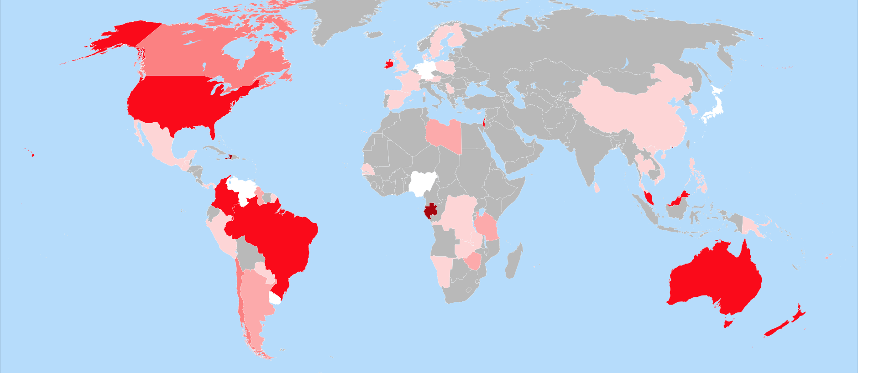
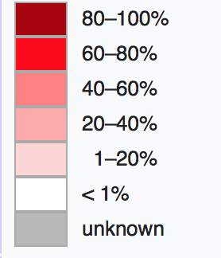
Percentage of population receives fluoridated water 2011
Notes:
Colors indicate the percentage of population in each country that receives fluoridated water, where the fluoridation is to levels recommended for preventing tooth decay. This includes both artificially and naturally fluoridated water.

Slide 22
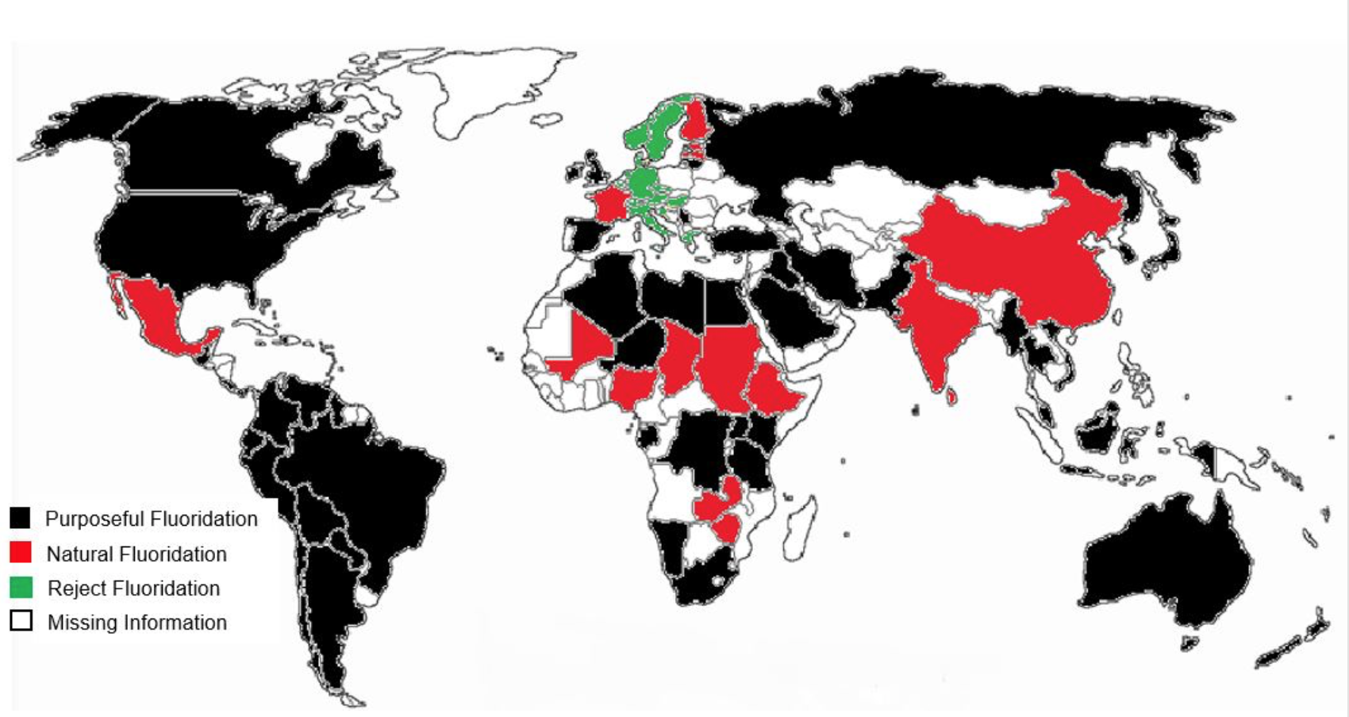
Which countries have fluoride in their water (2017)

Slide 23
In Quebec, the debate is still raging (2013)
As of 2013, only 8 cities across Quebec treat their water with Fluoride – Quebec’s public health authority is recommending that fluoride be used at a higher penetration rate
Citizen are divided, some of them would prefer to have the choice
Lobby groups such as “Eau Secours” believe that it poses health and environmental issues
This is a continuous debate

Slide 24

The Center for Disease Control and Prevention (CDC) calls it one of the 10 great public health achievements of the 20th century

Slide 25
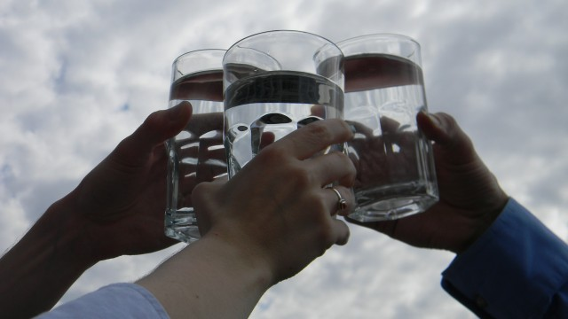
THE END
Thank you!

