Slide 1
The history of water fluoridation
Janie Coulombe

Slide 2

Two stories unfolded over more than 50 years:
Harmful effects of fluoride in large doses
Dental benefits from small doses

Slide 3
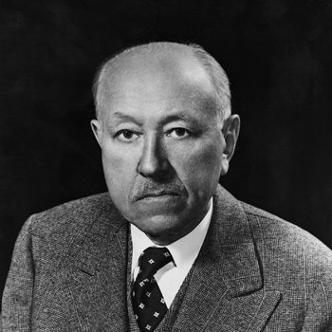
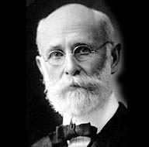
The first findings
First important mention of the fluorosis occurred in 1902 in El Paso County, Colorado by Frederick S. McKay, dentist
McKay gave systematic attention to the mottling and brown staining he found on the teeth of many of his patients and hypothesized it’s due to water supply
By 1908 McKay studied enough cases + interested enough colleagues to invite Dr. G. V. Black, Dean of Northwestern University Dental School

Slide 4
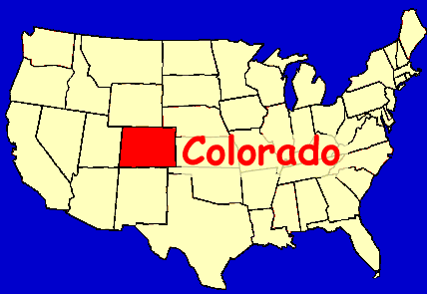
Harmful effects of fluoride
Black’s visit gained national attention to the phenomenon and afterwards, many cases were reported from other parts of the country
The name “Colorado brown stain” eventually gave way to that of mottled enamel and the process soon became associated with communal water supplies
Other stories - Kids in Idaho (1916), citizens of south Dakota (1925)

Slide 5
Harmful effects of fluoride
Studies initiated in 1928 in Bauxite, Arkansas, led to the final discovery that mottled enamel was associated with fluoride in water
An exceptionally high incidence of mottling occurred in Bauxite - action upon the problem was more far-reaching than usually because of presence of a plant of Republic Mining and Manufacturing Company
Samples of Bauxite water eventually came to the laboratory of H. V. Churchill, chief chemist for Alcoa, who initiated spectrographic study - 13.7 parts per million of fluoride found in the Bauxite water
McKay was notified in 1931

Slide 6
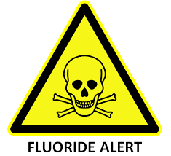
Harmful effects of fluoride
McKay arranged for reanalysis of the water supplies in Britton, South Dakota, Oakley, Idaho, and elsewhere
Subsequent rechecking in many parts of the United States soon developed a striking correlation between mottled enamel and a fluoride content of public water ranging from 2 to 13 parts per million
At the same time Smiths in Arizona and Velu in France made similar connection between mottled enamel and fluoride, but this didn’t spark as much interest

Slide 7
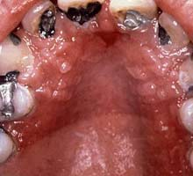
Benefits of fluoride on dental health
The coexistence of low dental caries and mottled enamel had excited comment from McKay, even in the early years of his investigation
After the discovery that fluoride correlated with mottled enamel in 1931, several other investigations also noted this inverse relation
1941-42. Dean HT reported on examination of 7,257 continuous-residence white children of 21 cities with differing amounts of fluorides in their community waters

Slide 8
Benefits of fluoride on dental health
Studies established:
  Children 12-14 who have continuously used water with an optimal fluoride concentration have, in general about two-thirds less dental decay than children who used fluoride-free drinking water
  Lessened amount of dental caries follows the use of a domestic water containing as low as 1.0 ppm of fluoride

Slide 9
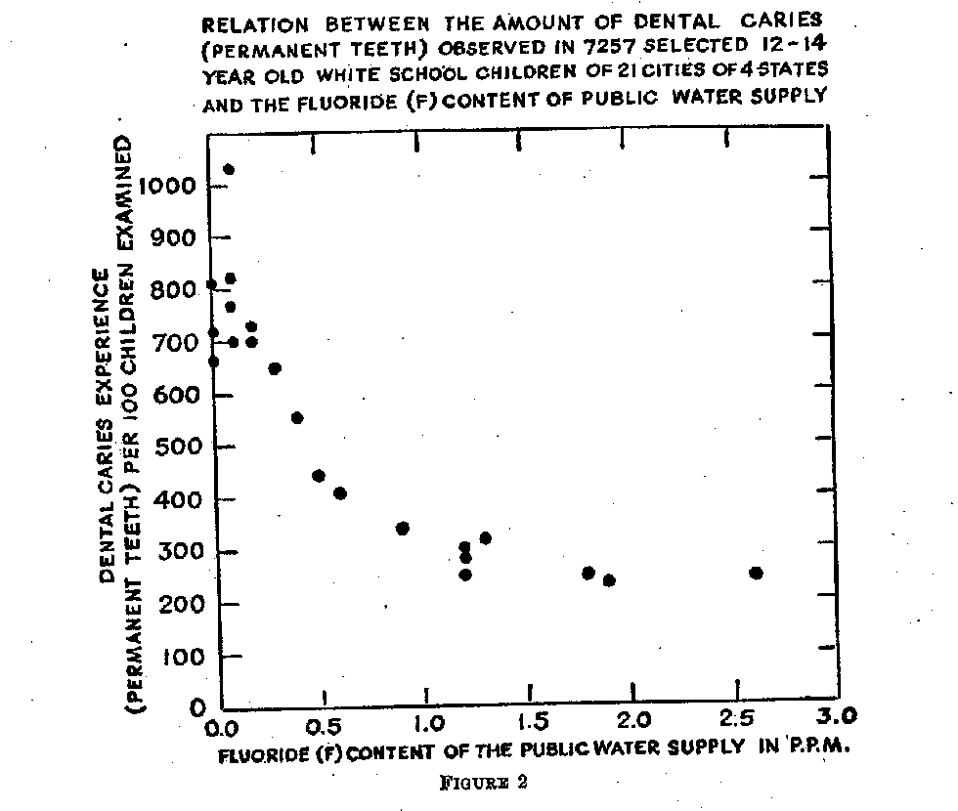
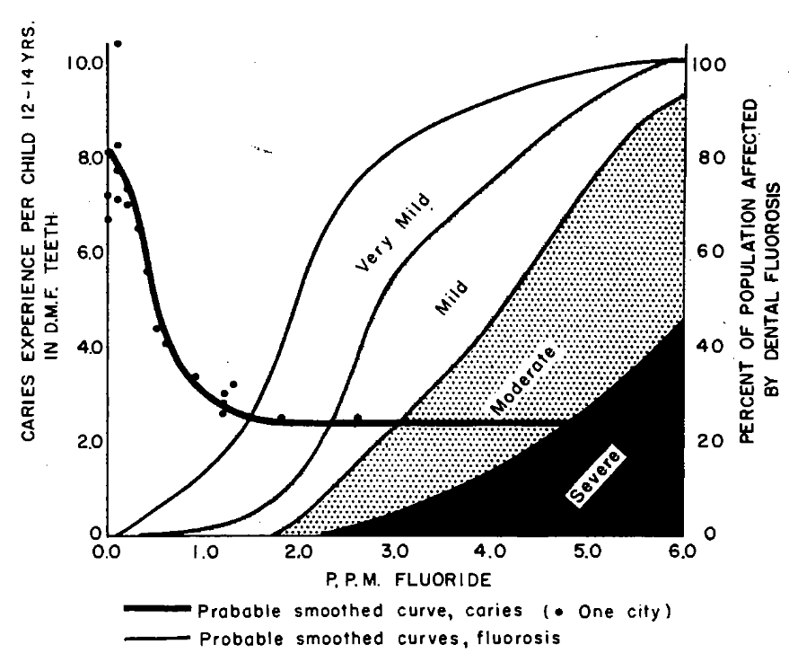

Slide 10
Benefits of fluoride on dental health
Pilots studies started in 1945 in New York, Michigan, Ontario
In Newburg, some complaints from citizen – stopped after the citizens knew that the treatment had not started yet
All reports showed improvements in Newburg and lack of improvement in Kingston (control)
At the same time, pediatric study (Kingston being the control) – after 10 years, no major issue or difference

Slide 11
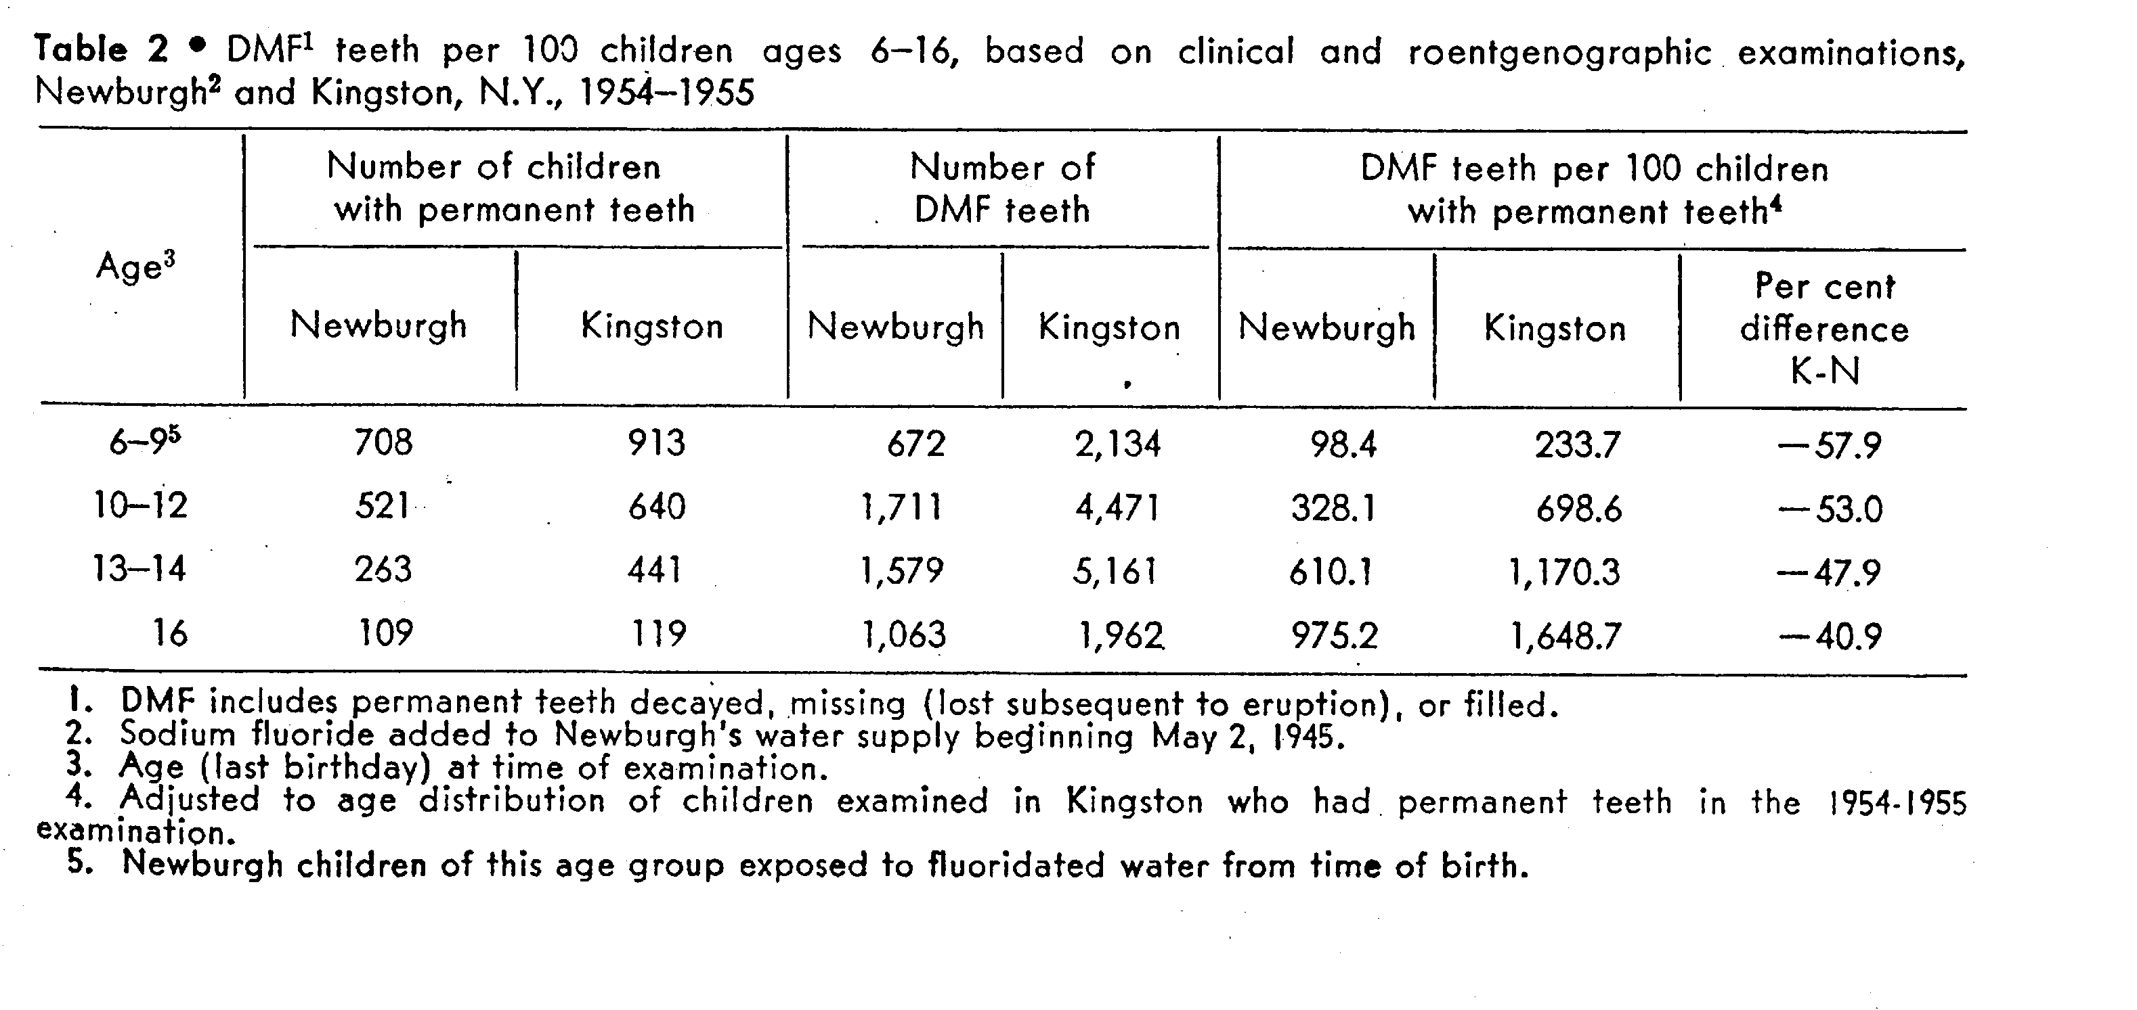

Slide 12
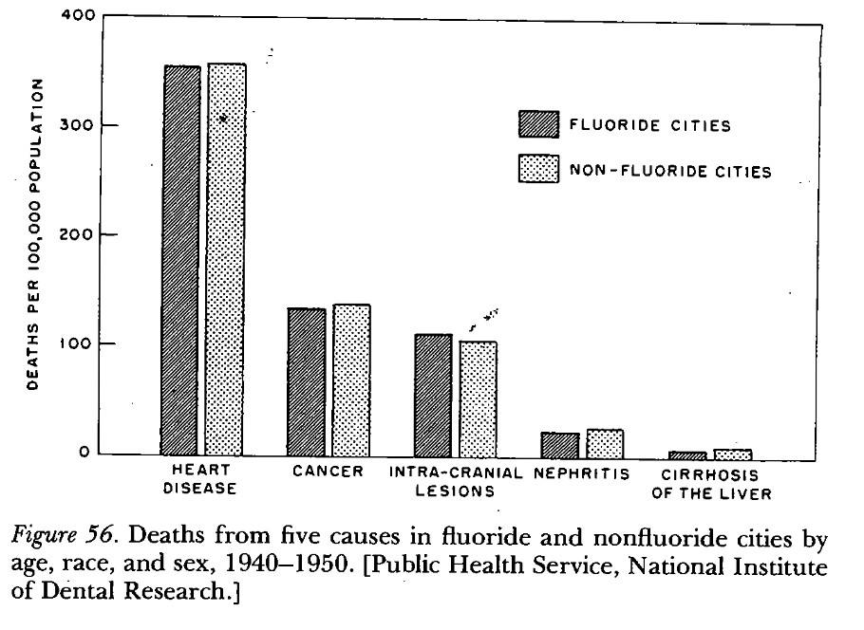

Slide 13

And since then…

Slide 14
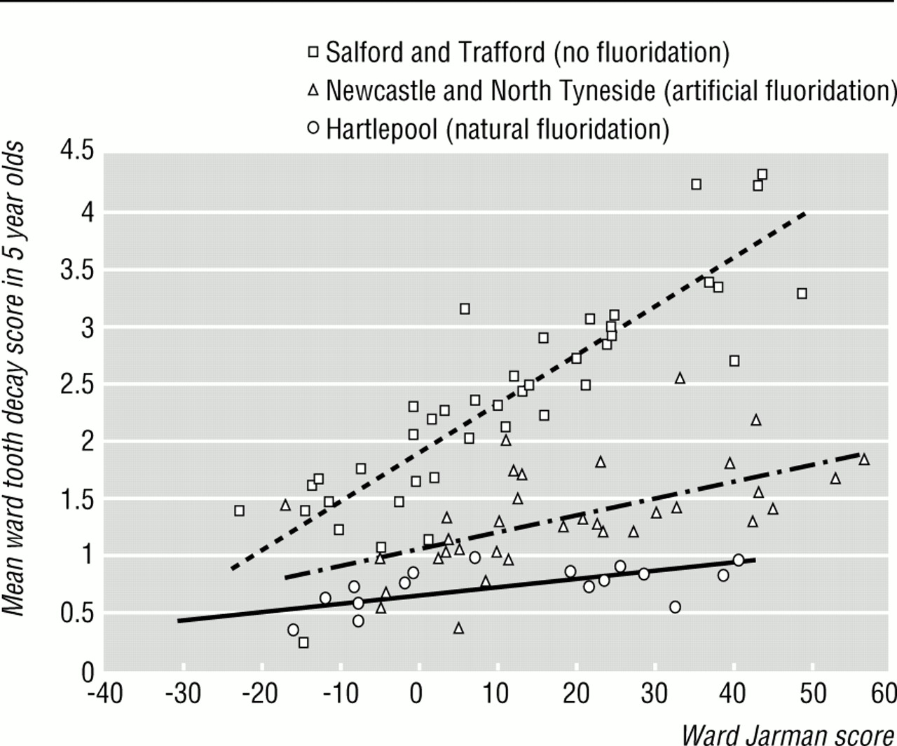
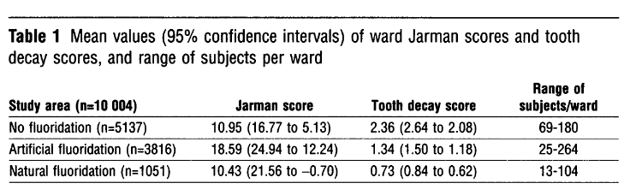
In relation with the social status (1991)
NHS dental surveys in 5 years old
1991 census – electoral wards in
Hartlepool, Newcastle and North Tyneside
(Fluoridated), and Salford, Trafford (Non)
N=10,004 children
Ward tooth decay score vs Jarman score
(underprivileged area score)

Slide 15
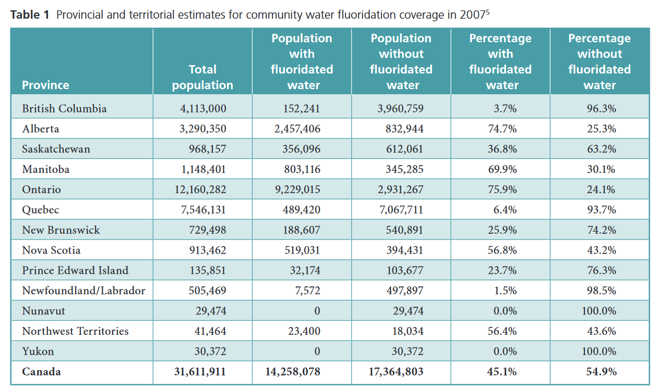
CMAJ – Canada (past and present)

Slide 16
Dental disease is the number one chronic disease in children, in North America
Research continues to show that fluoride reduces tooth decay (20 to 40%)
Advantage is, it benefits everyone regardless of age, socioeconomic status, education or employment
A panel of specialists concluded that 0.7 PPM would be enough
On the other side:
Cost of water fluoridation
Environmental pollution
Health risks
Infringement on human rights

Slide 17
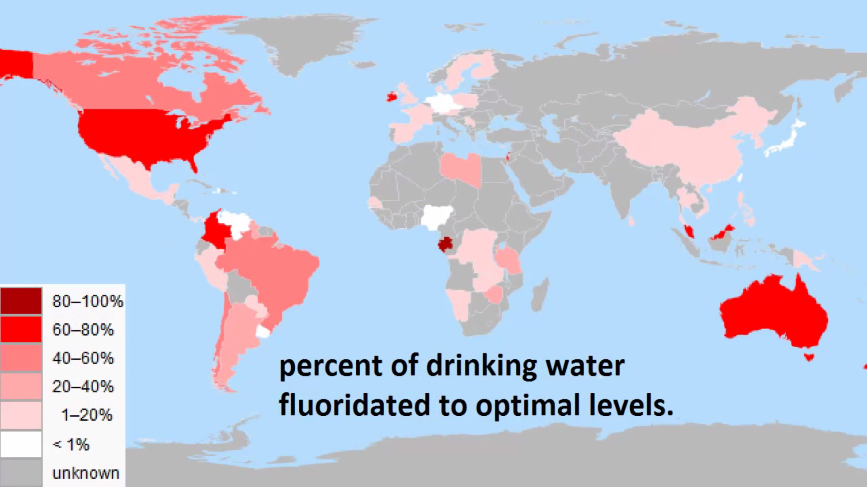
As of 2008…

Slide 18
In Quebec, the debate is still raging (2013)
As of 2013, only 8 cities across Quebec treat their water with Fluoride – Quebec’s public health authority is recommending that fluoride be used at a higher penetration rate
Citizen are divided, some of them would prefer to have the choice
Lobby groups such as “Eau Secours” believe that it poses health and environmental issues
This is a continuous debate

Slide 19
CMAJ – Study in Ireland (2014)
Extensive review of water fluoridation (they started adding fluoride in 1964)
To assess safety and effectiveness of water fluoridation
Critics draw links between health issues and water fluoridation + they don’t have a “choice”
Lower IQ in fluoride-exposed children?

Slide 20
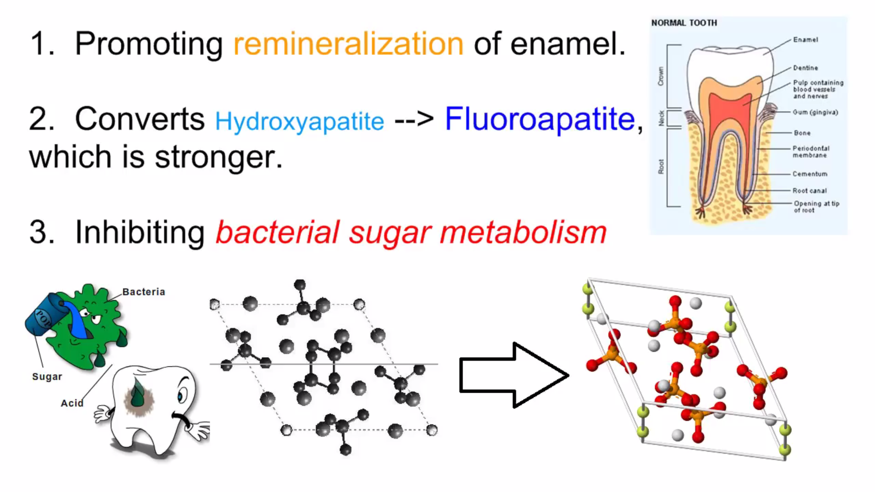
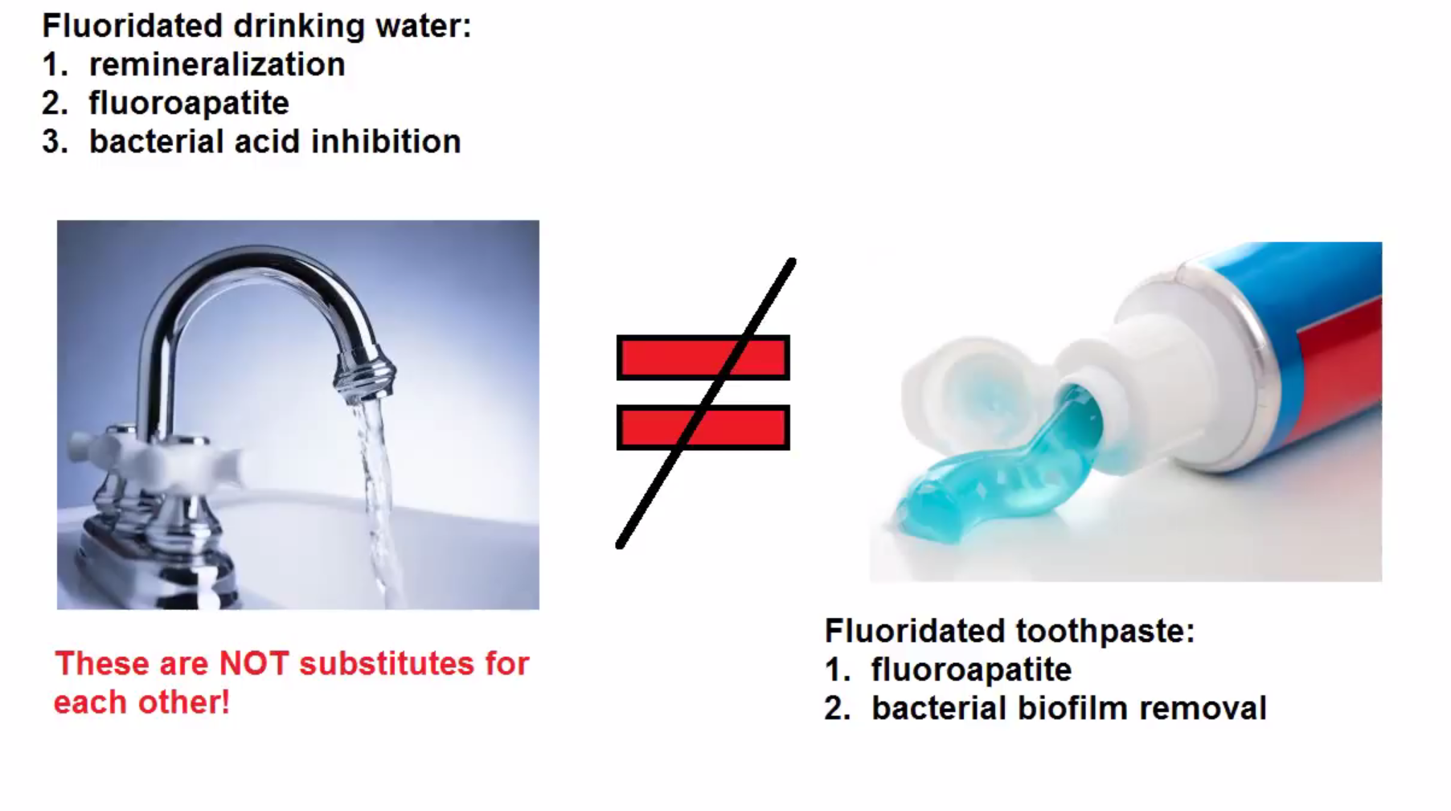
And according to a Youtub-er, benefits are due to…

Slide 21

The Center for Disease Control and prevention (CDC) calls it one of the 10 great public health achievements of the 20th century

Slide 22
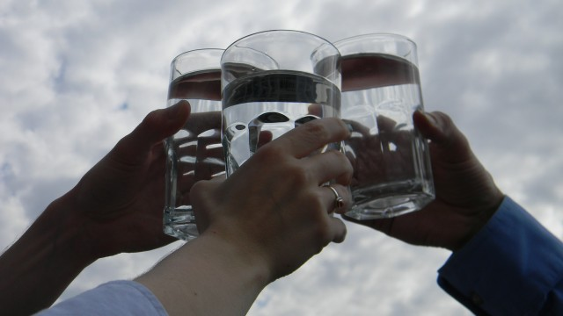
THE END
Thank you!

